Slide 1
Unicellular organisms –Protists four

Slide 3
What is a protists ?
Protists- Very diverse group of single-celled organisms from the Kingdom Protista.

Slide 4
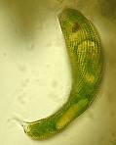
EUGLENA
Single-celled Protists= that lives in fresh water.
Heterotroph- Captures food by eating other organisms
Has chlorophyll

Slide 5
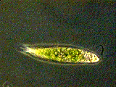
Euglena
Eyespot helps it sense light.
Movement by a flagella

Slide 6
AMOEBA
Found in freshwater and salt water.
Heterotroph- Captures food by eating other organisms

Slide 7
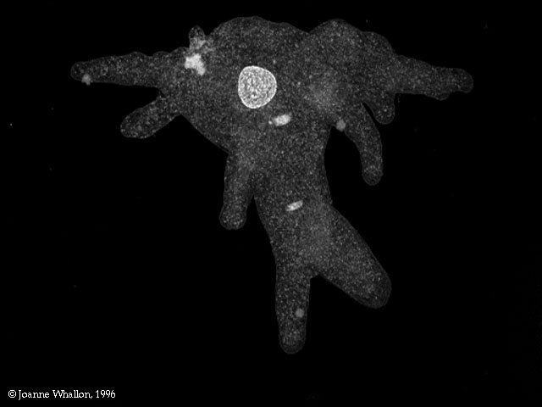
Amoebas
Movement- The cell shapes itself into pseudopods (false feet)
made by cytoplasmic streaming

Slide 8
PARAMECIUM
Found in freshwater.
Movement- cilia (tiny hairs that move back and forth.)
Heterotroph- Cilia also sweep food into the oral groove and gullet.

Slide 9
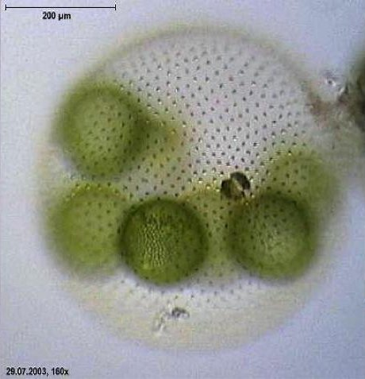
VOLVOX
Found in ponds ditches and puddles.
Composed of a colony of more than 50,000 tiny cells
Often called algae.

Slide 10
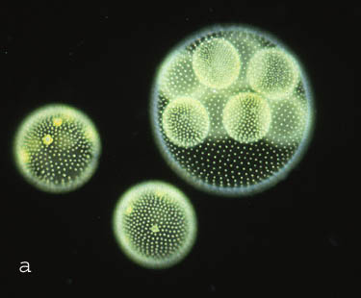
Volvox
Autotroph Photosynthesis
Eyespots sense light

